Slide 1

Monitoring Health of IOT Network Using Blockchain
Group No. 21
Rutuja Patole (17104011)
Rushika Ramane (17104064)
Soundarya Nevrekar (17104066)
Guide: Prof. Anagha Aher
Co- Guide: Prof. Neha Deshmukh

Slide 2

01
Introduction
02
Objectives
03
Problem Definition
04
Technological Stack
Contents
05
Review Suggestions
06
Proposed System Working
07
Prototype Design Demonstration
08
Plan of Paper Publication

Slide 3
Introduction
Millions of Internet of Things (IoT) devices are connected to different systems and networks, providing different services and performing different functions.
Examples of IoT applications include automated monitoring, control, management, and maintenance.
Limitations include the inability to monitor running software status in an IoT deployment in real-time that are vulnerable to attacks.

Slide 4
Objectives
Scalability
Security
Soundness
To give access to multitude of nodes to join or leave the
network, and their behavior will not have a bad impact
on the network.
The monitoring module can detect status change of target software and send message to the administrator terminal.
To ensure the security of blockchain network, so as to prevent the system from being destroyed by attackers.
Monitoring
To make sure that other nodes communicating with the node are honest, they will respond to the node’s request and send trusted block data it needs.
To ensure the accuracy of the monitoring module, false negatives and false positives can have bad impact on the system.
Accuracy

Slide 5
Problem Definition
Hackers have already deployed malware to exploit inter connected sensors and gained access to private networks.
Critical threats to their infrastructure because of unauthorised intrusions intending to disrupt, degrade, or destroy systems.
We intend to secure that by creating a reliable product that makes use of Blockchain technology.
Reference:
IoT Technological Development: Prospect and Implication for Cyber stability

Slide 6
Technological Stack
Software
Hardware
Arduino IDE
Thingspeak
Nodemcu
DHT11 Sensor
USB Cable

Slide 7
Review Suggestions
From where have we identified the need of security for industrial IOT devices?
Which IOT devices will be used for implementation?
Change the diagram of proposed working
Private or Public Blockchain? If using Ethereum, which API’s we will be using?
Who will be the end user of our system?
Website, mobile app or cloud service?

Slide 8
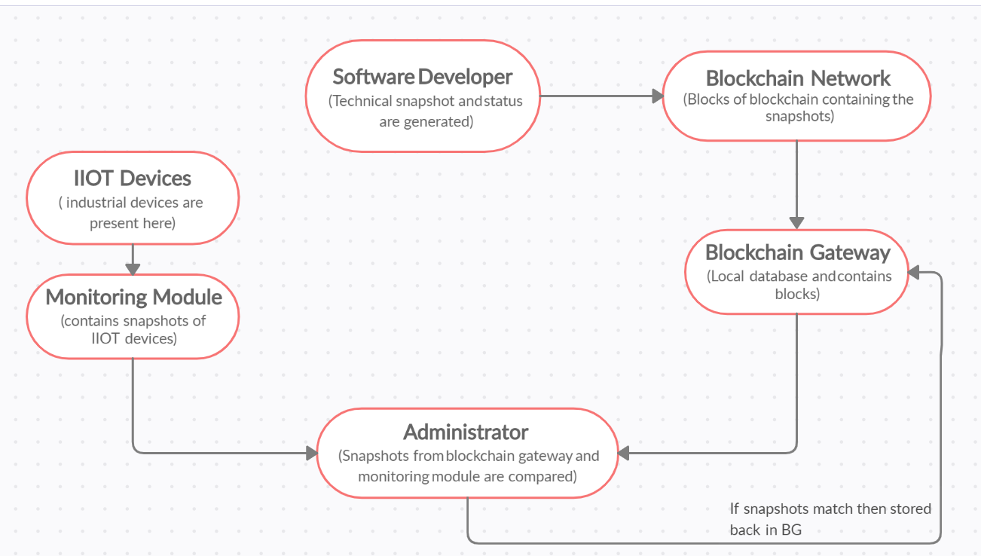
Proposed System Working

Slide 9
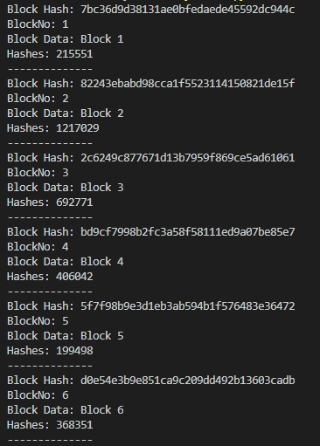
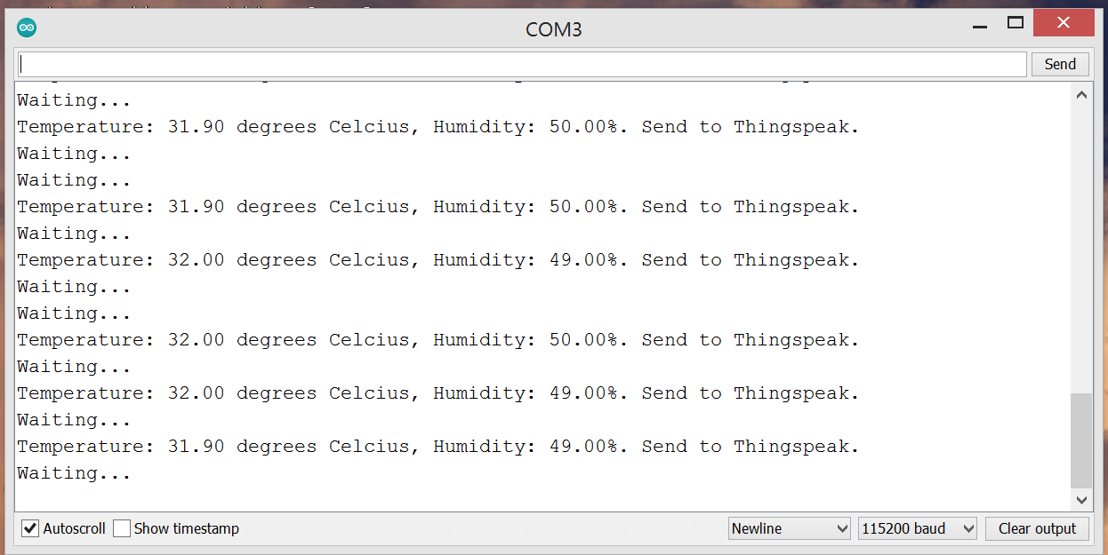
Prototype Design Demonstration

Slide 10
Plan of Paper Publication
Abstract Submission Deadline
06 January, 2021
13 January, 2021
Accepted Paper Submission Deadlines
Conference: 2021 IEEE 41st International Conference on Distributed Computing Systems (ICDCS)
Notification of Acceptance Date
17 March, 2021
07-10 July, 2021
Conference Dates

Slide 11

Thank You

